Slide 1
Stegomedia : Secure data hiding in images using steganography
CAPSTONE PROJECT
Presented By:
Student Name : Krushna Vitthal Rathod
College Name : Yeshwantrao chavan college of engineering Nagpur
Department: Artificial Intelligence and Data Science

Slide 2
OUTLINE
Problem Statement
Technology used
Wow factor
End users
Result
Conclusion
Git-hub Link
Future scope

Slide 3
Problem Statement
In today's digital world, keeping communication secure is more important than ever. Traditional encryption methods, while effective, can sometimes draw unwanted attention, making them targets for attacks. Steganography offers a more discreet approach by hiding messages within images, making them nearly invisible to prying eyes.
Our project takes this a step further by implementing a password-protected image steganography system. This ensures that only authorized users can hide and retrieve messages, adding an extra layer of security. With an easy-to-use interface, our system provides a reliable and seamless way to exchange confidential information, making it ideal for sensitive environments.

Slide 4
Technology used
Frontend (React) :
React.js : JavaScript library for building UI
Axios : To send API requests
Tailwind CSS : For styling
React Router : For navigation
Vercel : Hosting platform
Backend (Node.js & Express) :
Node.js : JavaScript runtime for server
Express.js : Web framework for handling API requests
Multer : Middleware for file handling (image upload)
Crypto : For encryption & decryption
SteganoJS (or custom algorithm) : Hides text inside images
Render : Hosting backend

Slide 5
Technology used
Software
Development Environment:
Operating System: Windows 10/11
NPM: Latest version for package management
Code Editor: VS Code
Git: Installed for version control
Frontend (React + Vercel)
React.js (Latest version)
Tailwind CSS for styling
Axios for API requests
React Router for navigation
Backend (Node.js + Express + Render)
Node.js (v18+)
Express.js for REST API
Multer for file handling
Crypto module for encryption/decryption
CORS & Body-parser for API requests
Hardware:
Intel Core i5 processor
8GB RAM
512SSD
Internet

Slide 6
Wow factors
Dual-Layer Security (Encryption + Password Protection)
Unlike basic steganography tools, StegoMedia encrypts the message before hiding it in an image.
It also requires a password for decryption, making it highly secure and resistant to unauthorized access.
Seamless Web-Based Experience
No software installation required—everything runs entirely in the browser!
Users can encrypt and decrypt images from any device (PC, mobile, tablet) without additional setup.
Fast & Lightweight Processing
Uses optimized encryption algorithms to ensure minimal processing time for encoding and decoding messages.
Unlike traditional tools, there’s no noticeable image quality loss after encryption.

Slide 7
Wow factors
Universal Image Format Support
Supports PNG, JPG, JPEG formats for encoding messages into images.
Allows users to upload custom images instead of relying on pre-set ones.
Error Handling & User-Friendly Messages
Clear error messages for incorrect passwords or corrupted files.
Real-time feedback ensures a smooth and hassle-free experience.
Open-Source & Expandable
The project is fully open-source, meaning developers can extend and improve it over time.
Can be integrated into cybersecurity applications for secure communication.

Slide 8
End users
Cybersecurity Professionals
Government & Intelligence Agencies
Healthcare & Medical Professionals
Journalists & Whistleblowers
Businesses & Corporate Teams
Financial Institutions & Banks
Ethical Hackers & Cybersecurity Enthusiasts
Students & Researchers
Digital Artists & Content Creators
Privacy-Conscious Individuals

Slide 9
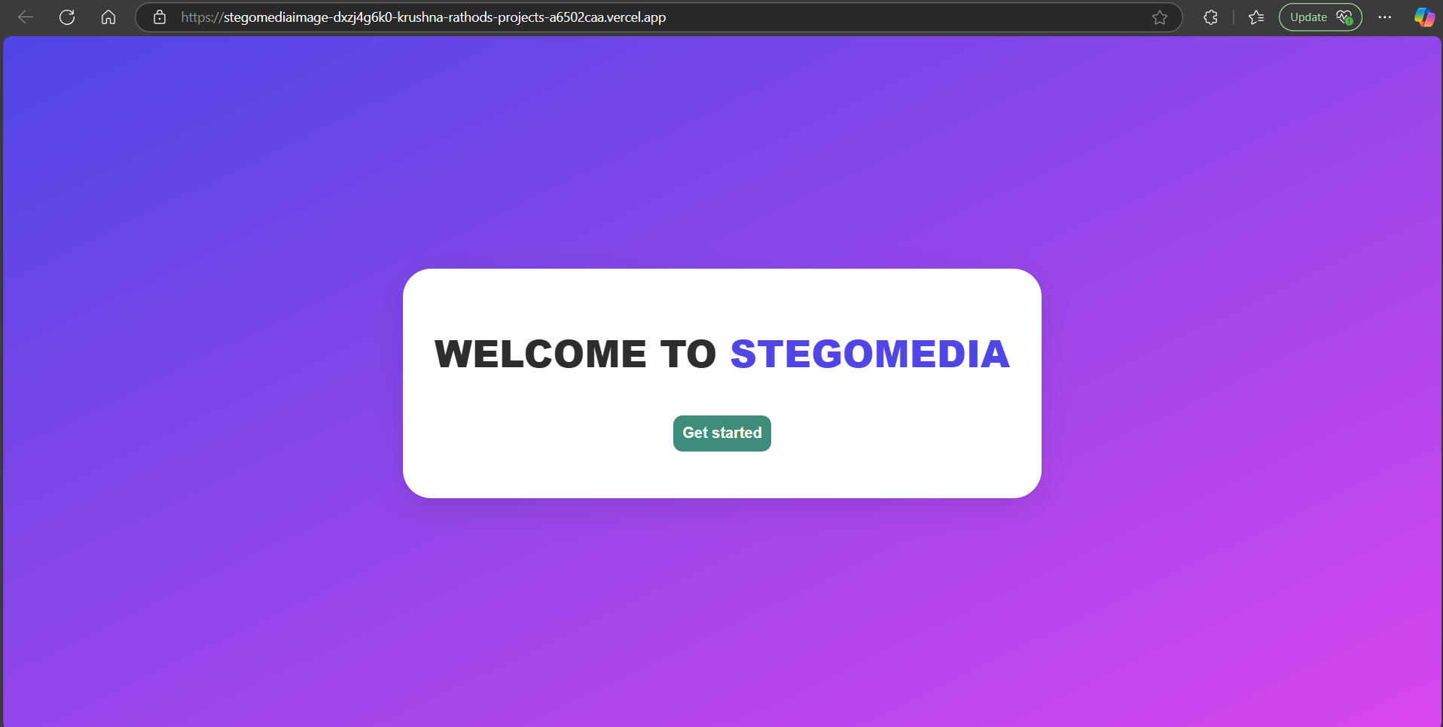
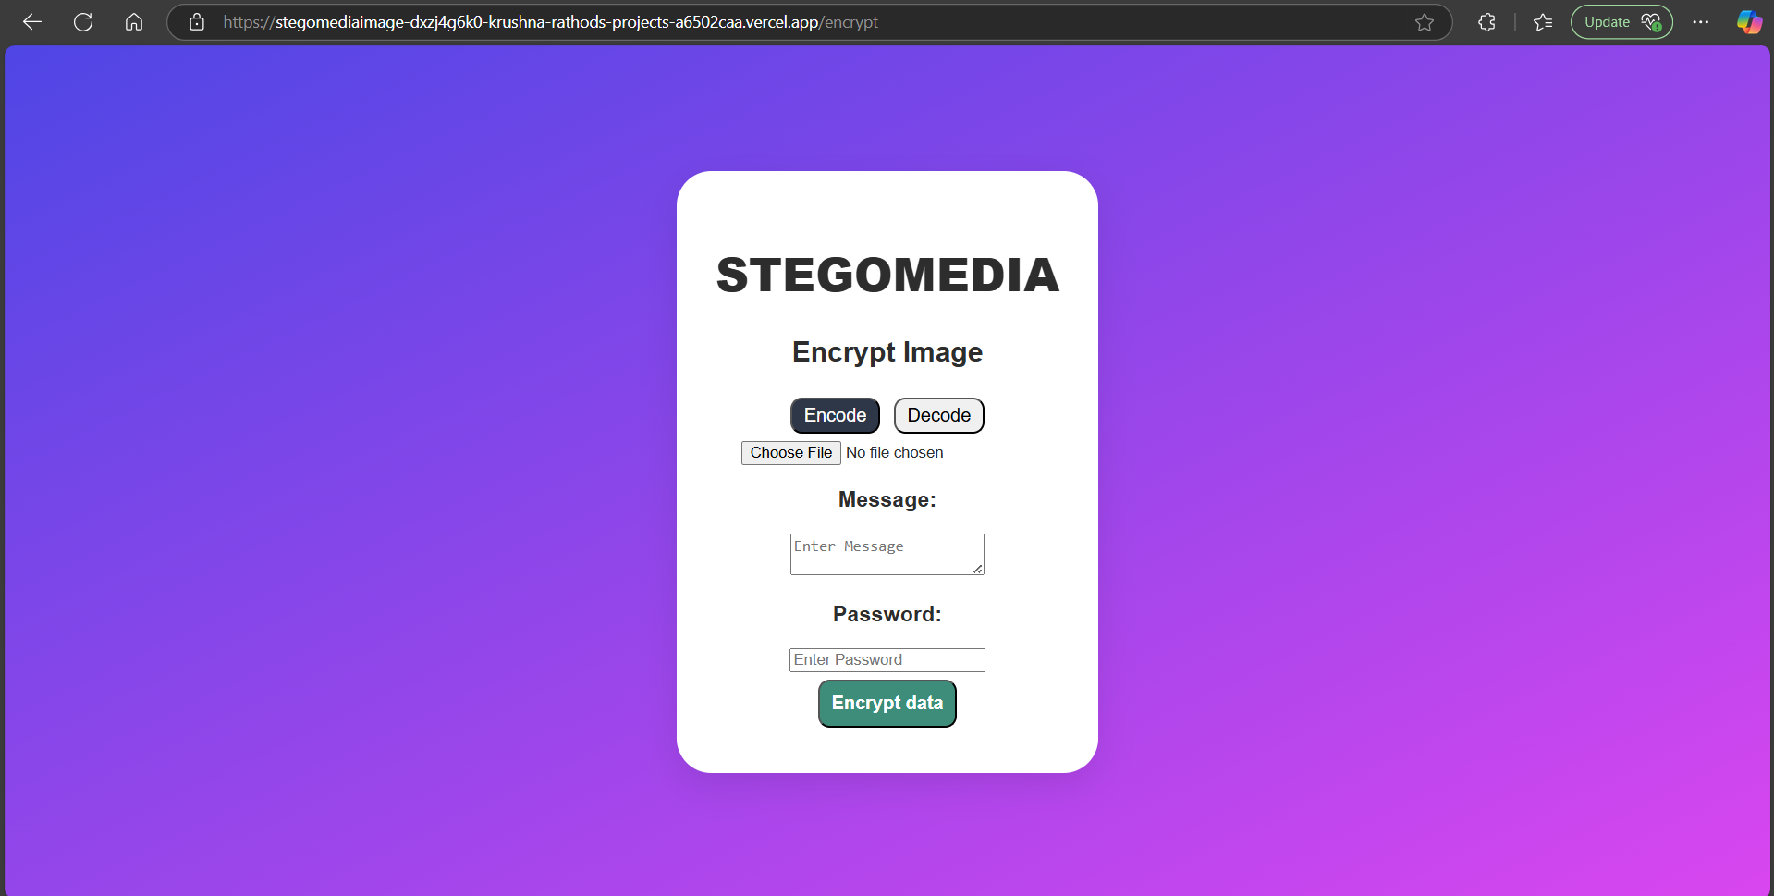
Results (on Desktop)

Slide 10
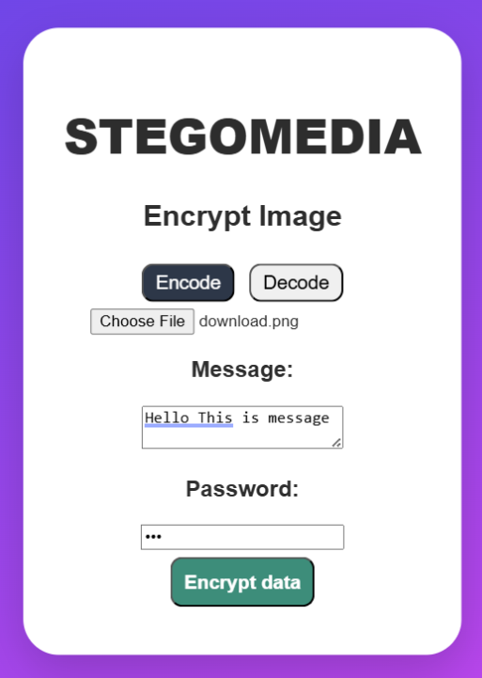
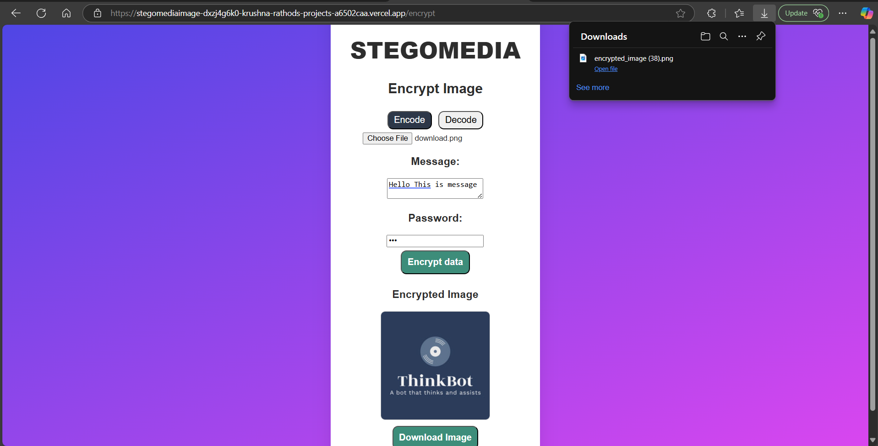
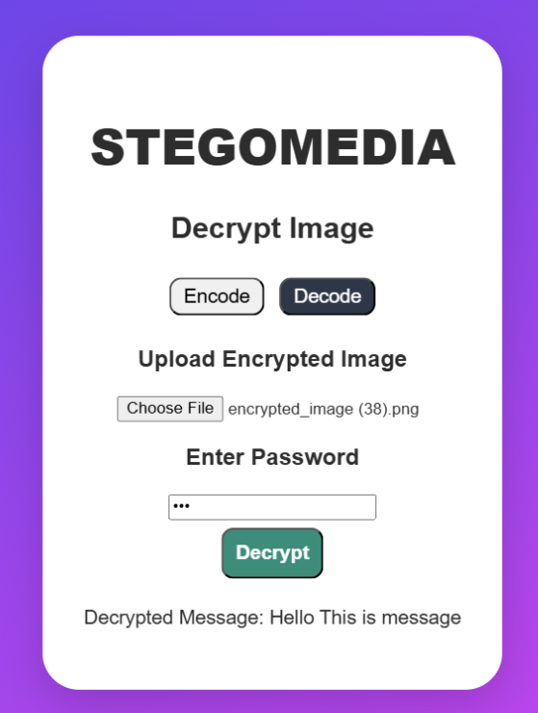
Results (on Desktop)

Slide 11
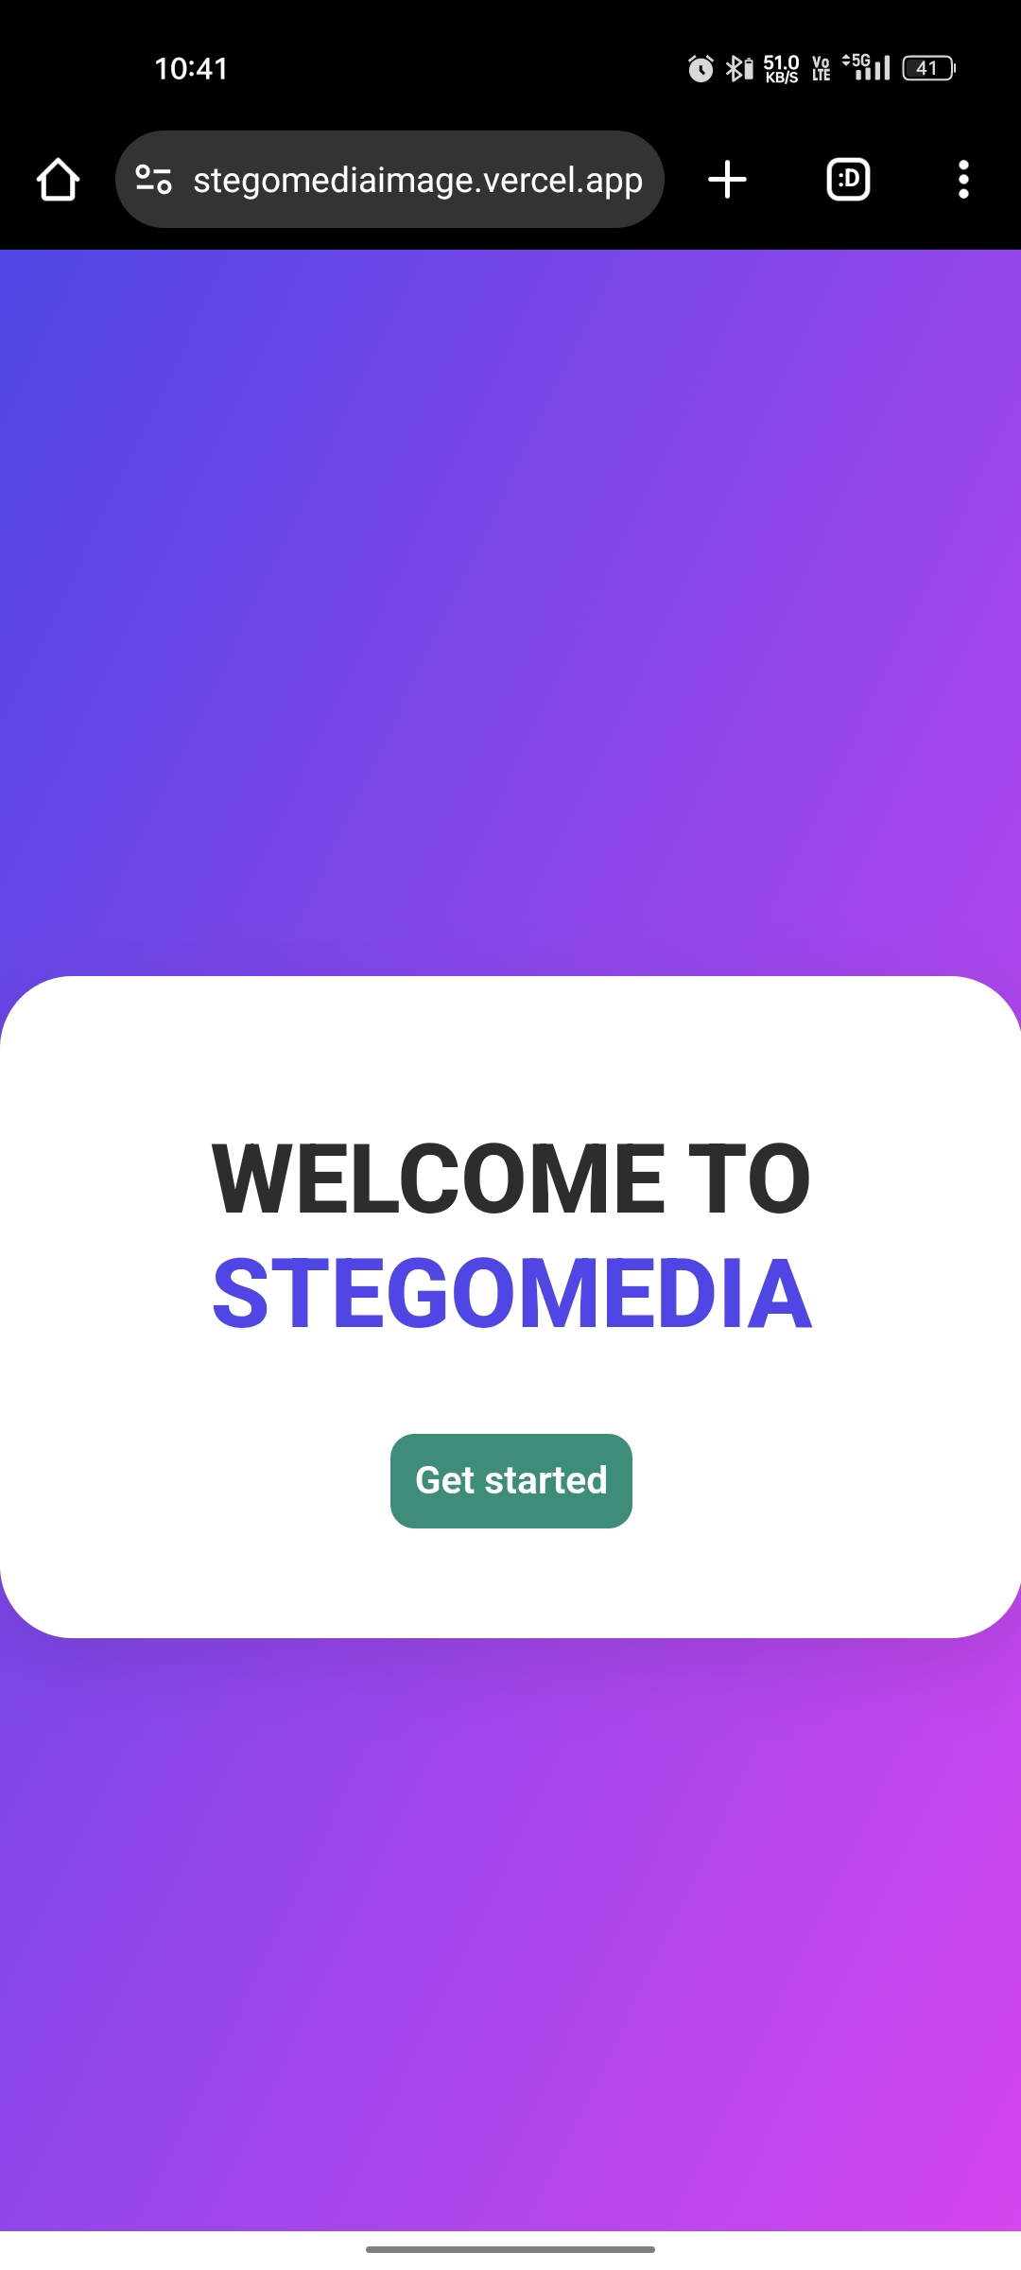
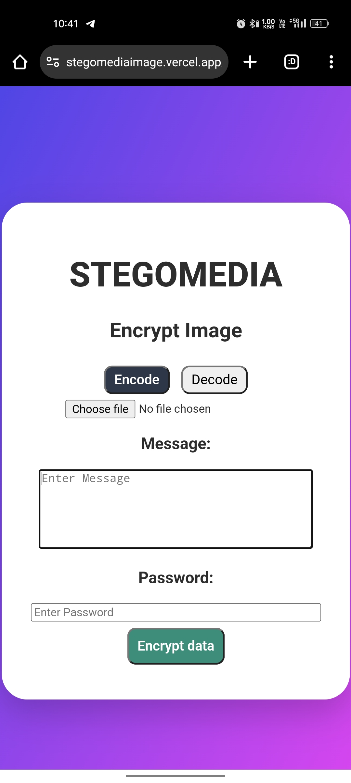
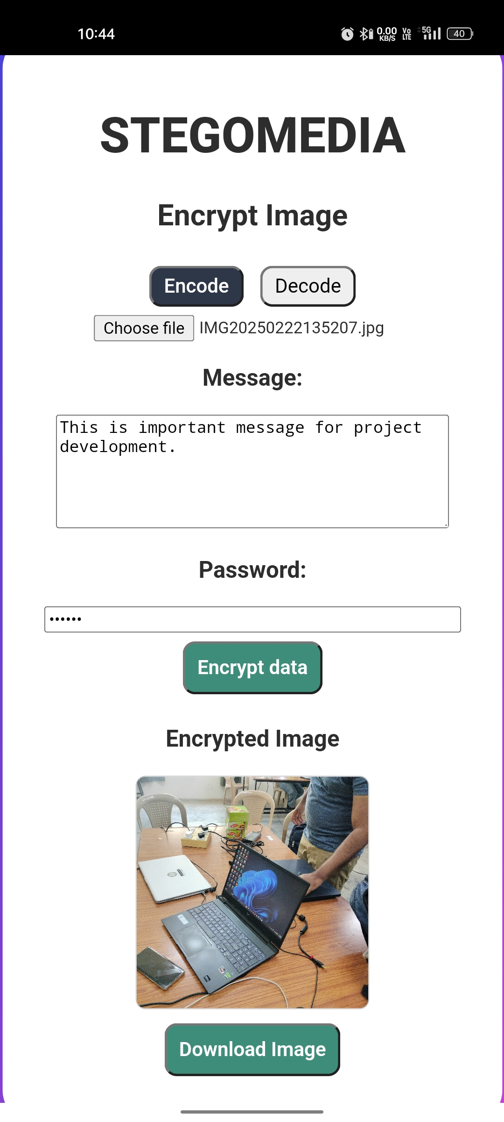
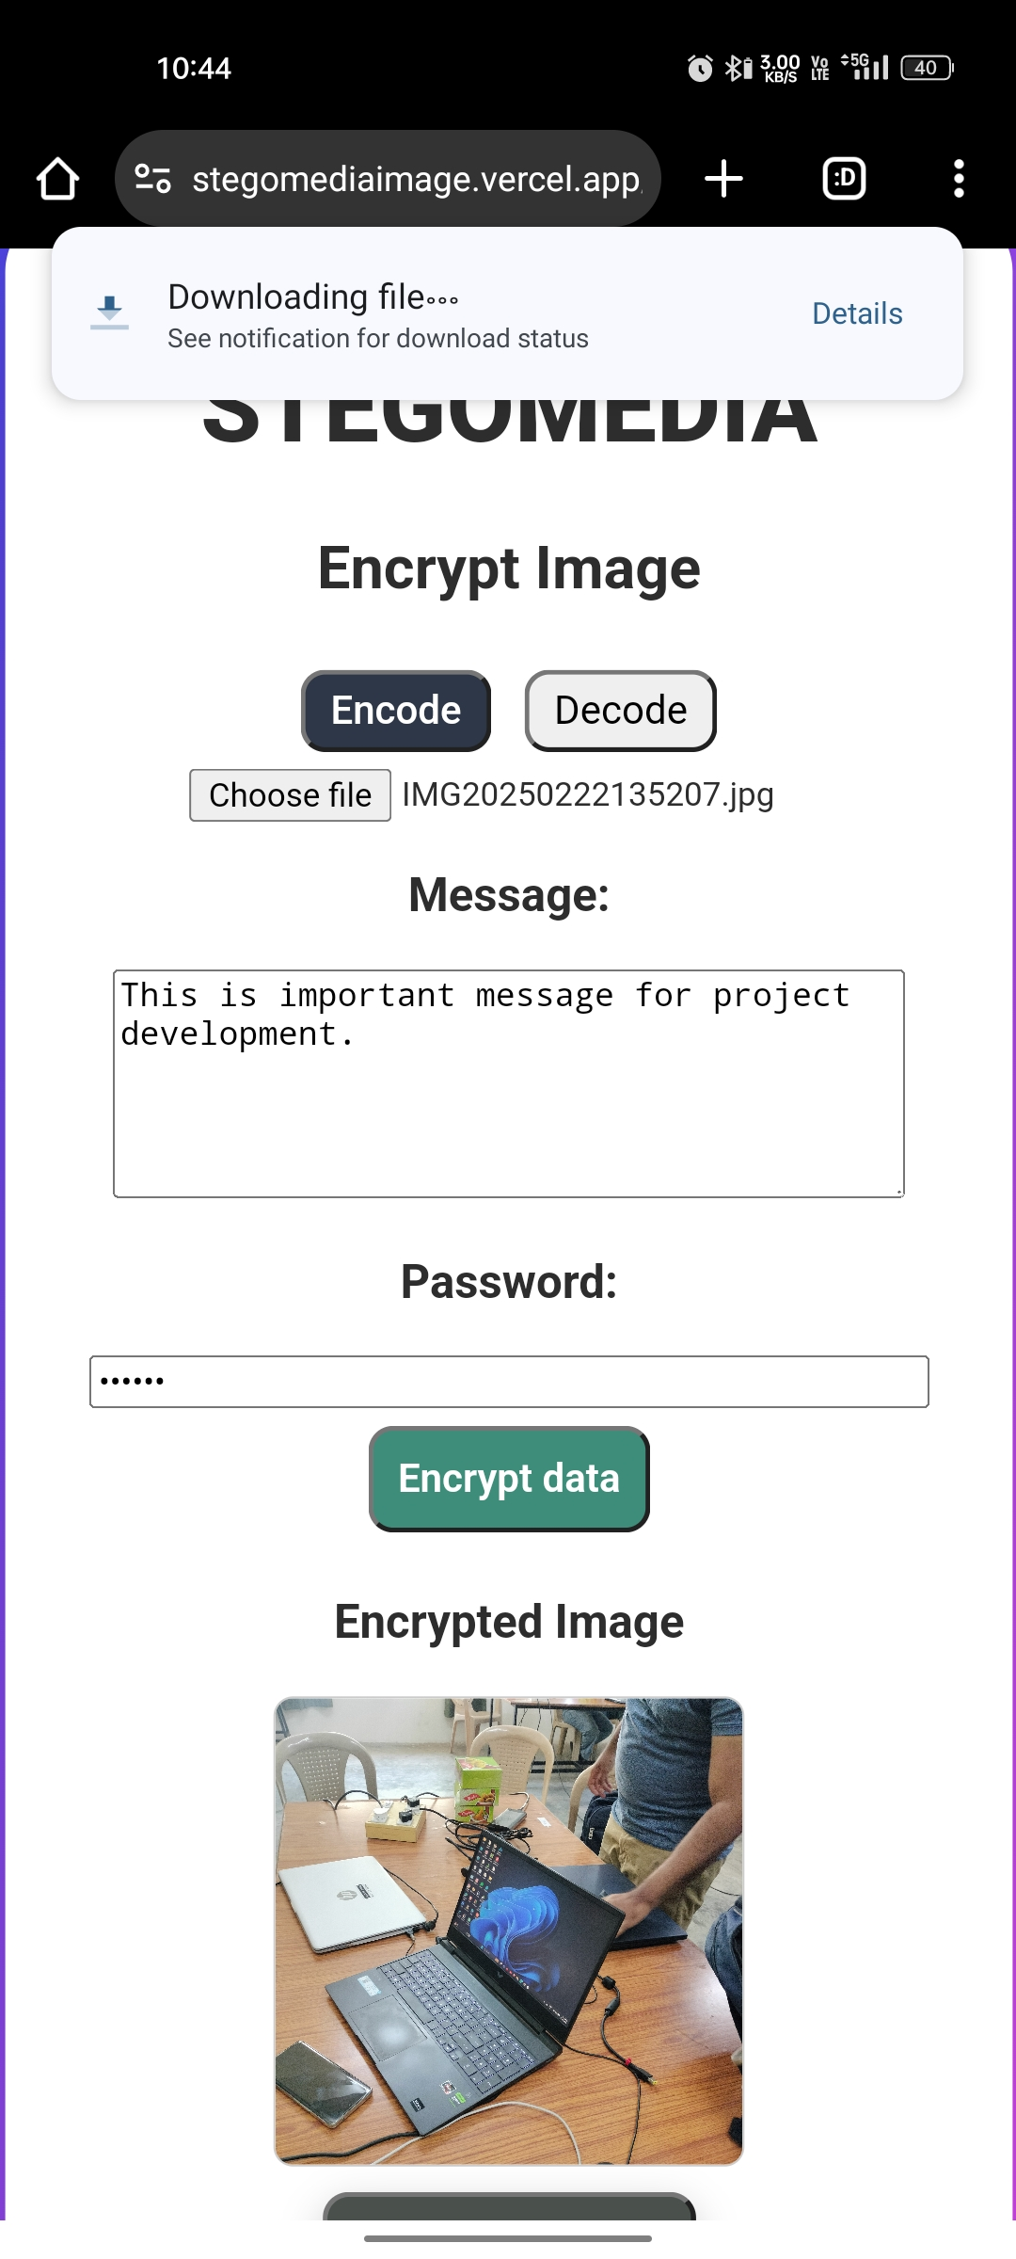
Results (On Mobile)

Slide 12
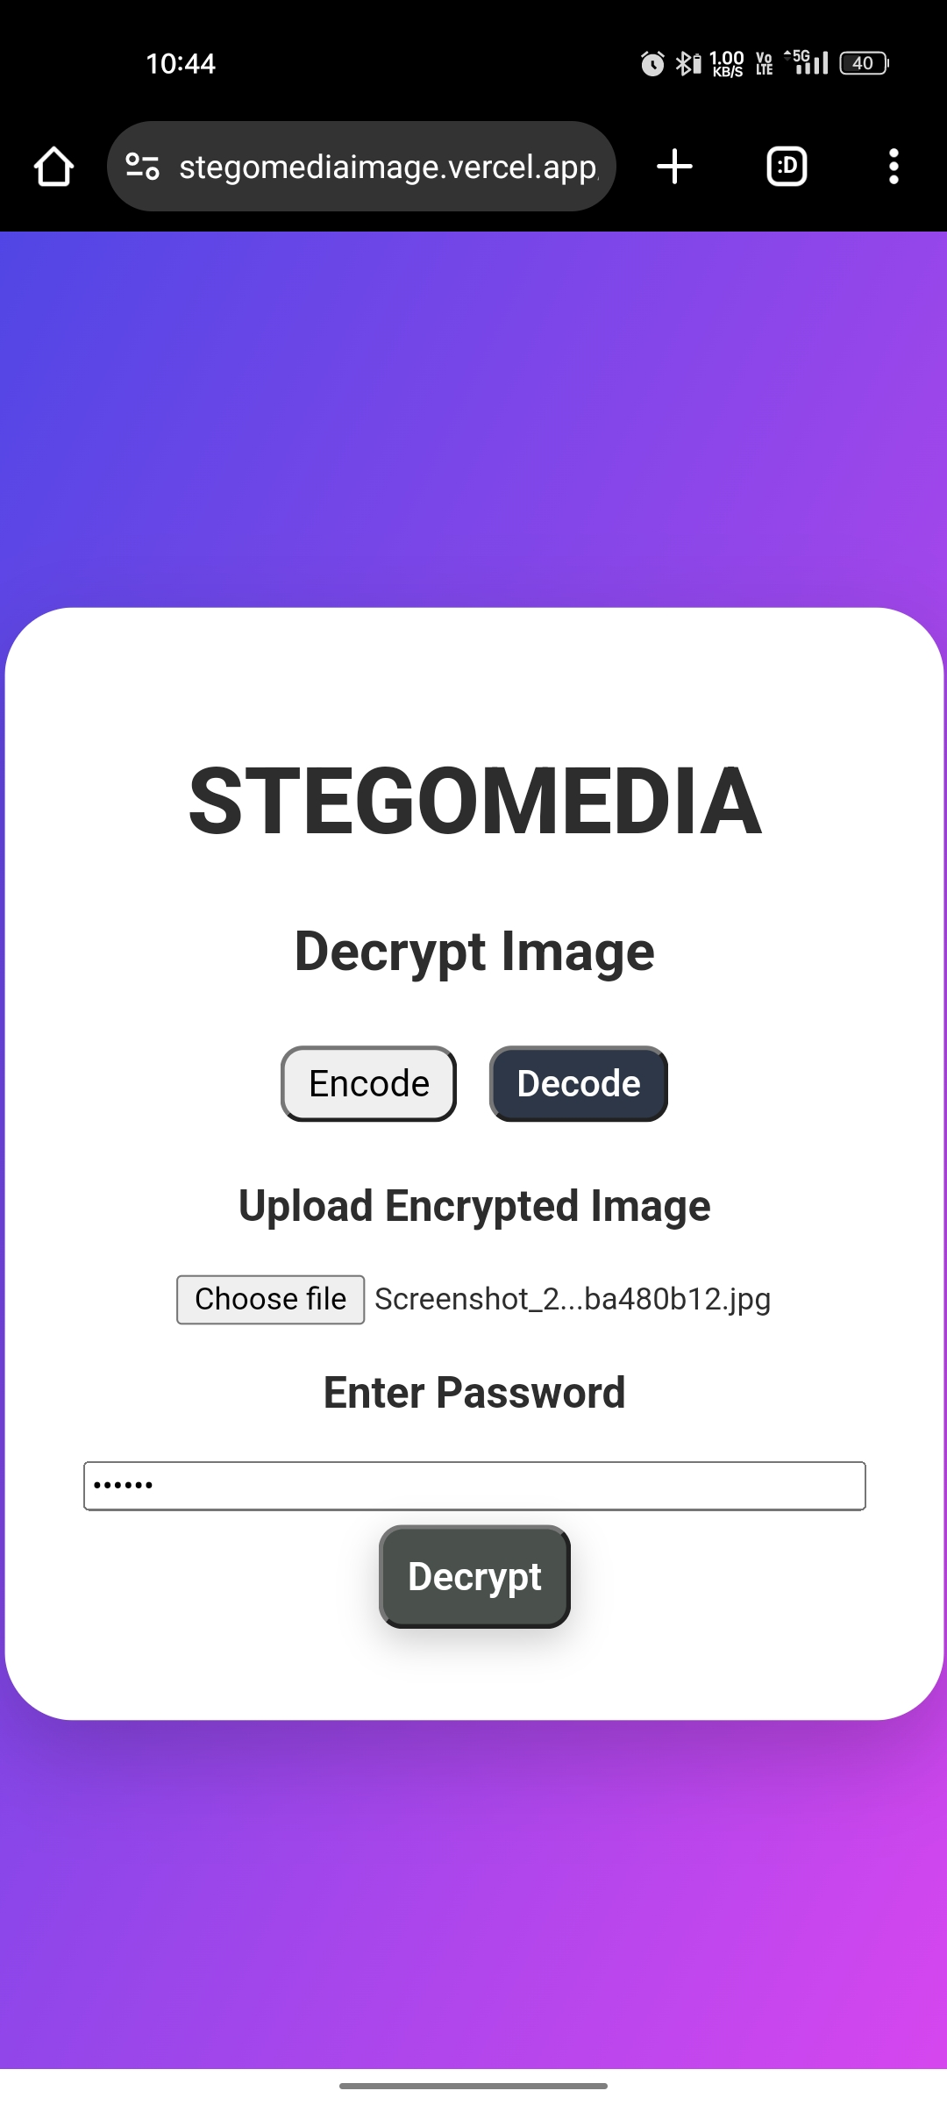

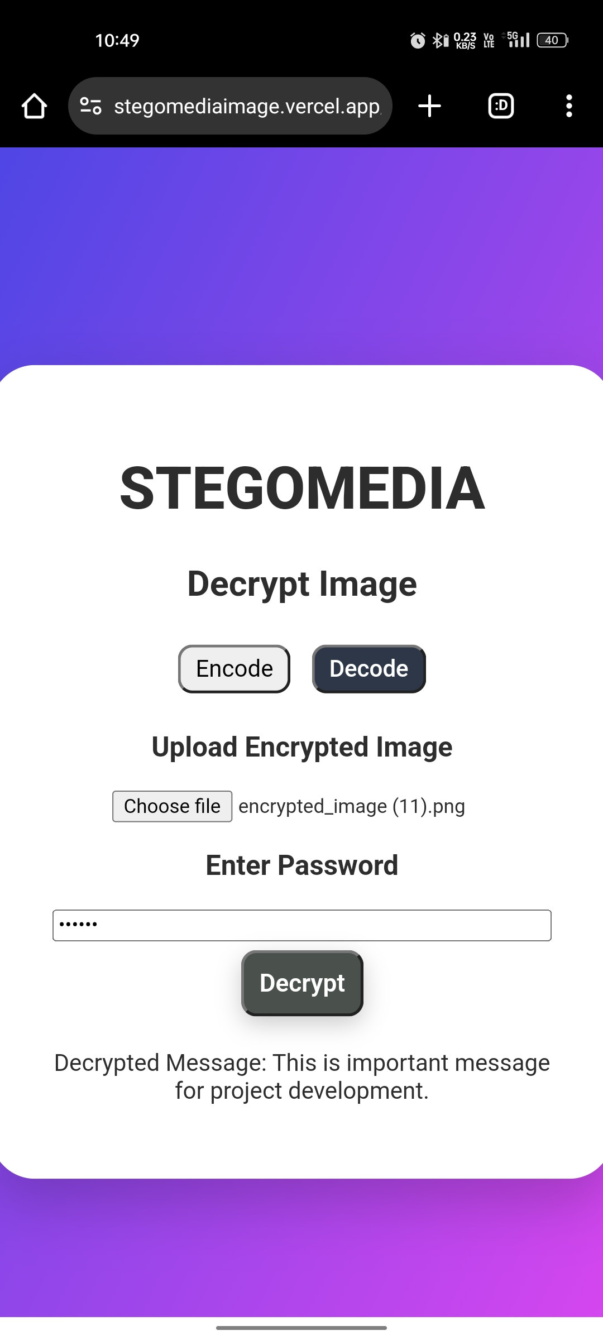
Results (On Mobile)

Slide 13
Conclusion
In today's digital age, data security and privacy are major concerns, with cyber threats and unauthorized data access becoming increasingly prevalent. StegoMedia addresses this problem by providing a secure, user-friendly, and efficient way to hide sensitive messages within images using steganography.
By implementing image-based encryption and decryption, users can safely store and transmit confidential data without attracting attention. Unlike traditional encryption methods that can be flagged or detected, steganography ensures that hidden messages remain invisible to unauthorized users, making it a valuable tool for secure communication.
This project successfully demonstrates how React, Node.js, Express, and Firebase can work together to create a full-stack steganography application. With real-world applications in cybersecurity, forensics, and private communication, StegoMedia provides a robust foundation for future advancements in digital privacy.

Slide 14
GitHub Link
If you want to run on local host use below github code:
https://github.com/krushna1133/StegoMedia.git
If you want to run on network the deployed github code :
https://github.com/krushna1133/stegomediaimage.git
Website/app Link Compatible for All devices (PC, Mobiles, Tablet)
https://stegomediaimage.vercel.app/

Slide 15
Future scope(optional)
Advanced Encryption & Security Upgrades
Upgrade to AES-256 encryption for enhanced security.
Implement multi-layer encryption for even stronger protection.
Introduce biometric authentication (fingerprint/face recognition) for access control.
Mobile App Development (iOS & Android)
Develop a mobile app version for both Android & iOS.
Implement offline mode to encrypt/decrypt without an internet connection.
Add a QR code-based decryption system for enhanced ease of use.
Support for Various Media Types
Video and Audio Steganography: Extending support beyond images to hide messages in video and audio files.
Text Document Embedding: Encrypting messages within PDF or DOCX files for professional communication.

Slide 16
THANK YOU

